Slide 2
Mastering the Affiliate Game:
Tips and Tricks
Speakers:
Faith Glasgow of Peak Limousine
Jay Bowers of AJL International
Jason Dornhoffer of United Private Car
Moderator: Tiffany Hinton of MOTEV LLC
AV Sponsor
Coffee Sponsor

Slide 3
Welcome & Thank You to Our Sponsors
AV Sponsor
Coffee Sponsors

Slide 4
Key Questions to Consider Before Starting Your Affiliate Journey
What matters most to my affiliate?
How can I offer consistent service?
How can I be profitable offering affiliate services?
What technology will make accepting work easier?
What is my marketing plan for attracting business and reciprocating work?
AV Sponsor

Slide 5
Best Practices for a Farm-Out Company
Best Practices for a Farm-Out Company
1. Evaluating the Affiliate's Fleet and Chauffeur Protocols
Fleet Quality: Ensuring the fleet meets the standards your client expects
Chauffeur Dress and Conduct: Affiliate chauffeurs must adhere to high dress and conduct standards
Operational Protocols: Clear guidelines on how chauffeurs should interact with passengers
AV Sponsor

Slide 6
2. Selecting the Right Affiliate for Your Clientele
Insurance and Operating Authorities: Ensuring the affiliate is fully compliant and insured
Employee Status (1099 or W2): Importance of understanding the affiliate's employee structure
24/7 Communication: Ensuring round-the-clock availability for seamless communication
Technology Integration: Systems like GNet or livery-to-livery software
Notification of Changes: Setting expectations for instant notification of driver/vehicle substitutions
AV Sponsor

Slide 7
3. Incident Handling
Proactive and immediate responses in case of accidents or service issues
Transparent communication
4. Discussing Rates and Payment Terms
How to approach rate discussions, including common routes
Clarify payment timelines and policies to avoid misunderstandings
AV Sponsor

Slide 8
5. Maintaining Attitude and Professionalism
Attitude Matters: How you treat affiliates impacts the relationship; avoid condescension or entitlement
Customer Service Consistency: Ensure the affiliate is as courteous to you as they are to their own clients
6. Handling VIP Clients
Special considerations for VVIP clients
Assigning your best chauffeurs and ensuring flawless execution
AV Sponsor

Slide 9
Best Practices for a Farm-In Company
Preparation to Accept Affiliate Work
Technological Readiness: Do you have the right systems to accept affiliate work?
Training: Establishing SOPs for affiliate work, including training staff to handle affiliate needs
Understanding Expectations: Create a training program around affiliate needs and courtesies
Financial Readiness
Payment Terms: Understanding the payment structures and assessing whether you can sustain multiple affiliate relationships with extended payment terms
Responding to Mistakes
Owning Up to Errors: Handling incidents with transparency, learning from mistakes, and making internal changes to avoid recurrence
Communication: Proactively informing affiliates about any issues and detailing resolution steps
AV Sponsor

Slide 10
4. Frictionless Service
Being Flexible and Easy to Work With: Avoid rigid protocols when working with affiliates; understand their needs and adapt accordingly
Boundaries: While flexibility is important, also set clear, professional boundaries
5. Earning Inbound Work
Asking for Work: Don’t be shy to ask for inbound work as well as their pain points to avoid
Building Trust:
Treat the affiliate relationship with the same care as your direct clients
Don’t feel discouraged if you don’t receive trips right away; building a strong relationship is a gradual process
6. Affiliate Relationships
Understanding the Client/Passenger Dynamic: The affiliate is your client, but the person in the backseat is the passenger – balance the needs of both
AV Sponsor

Slide 11
Ten Keys to a Successful Affiliate Relationship
Build Trust
Be Proactive
Communicate Effectively
Top-Tier Training (Office/Chauffeur Team)
Integrity and Professionalism
Consistency
Responsiveness
Be Easy to Work With
Understand Expectations
Golden Rule: Treat affiliate relationships as you’d like to be treated.
AV Sponsor

Slide 12
Questions?
AV Sponsor

Slide 13
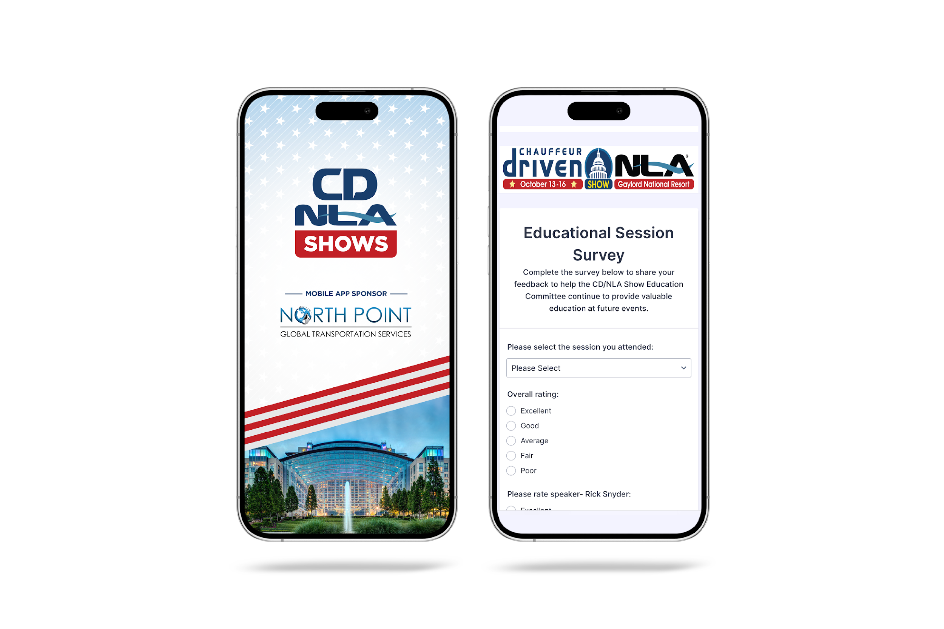
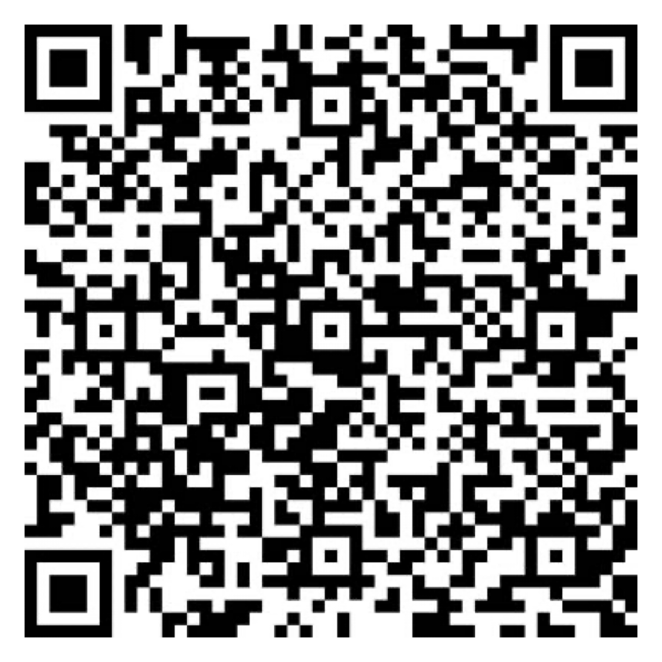
Let Us Know How
We Did!
Fill Out the Survey
AV Sponsor
Coffee Sponsor

Slide 14
Thank You for Joining Us!
AV Sponsor
Coffee Sponsor

